Slide 1
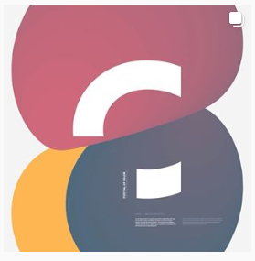
Patrick Hübner
Cutting edge communication with creative technologies

Slide 2
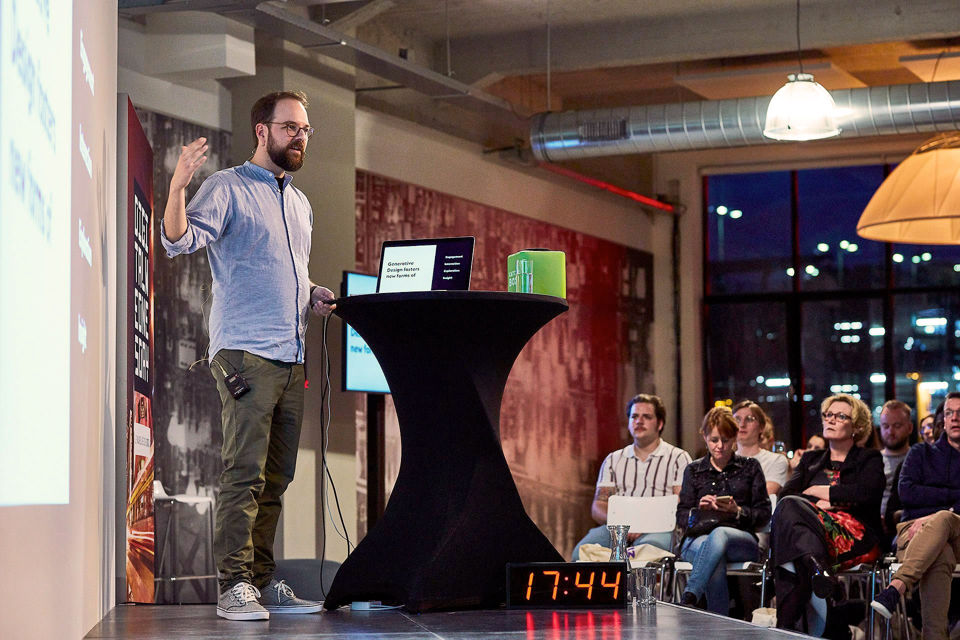
About

Slide 3
Worked within Corporate Design
10+ Years of experience as a Creative Director for leading national and international brands
Develops brand “experiences”
Often interactive artwork
Focused on communication and meaningful engagement with audiences
His work tends to be more immersive
Background

Slide 4
Art inspired by data, human interaction, artificial intelligence and storytelling
Focused on communication design
Known for his work in generative design
Uses his research in communication to develop brand experiences of the future
Purpose

Slide 5
Artwork

Slide 6
It is a method of applied design
Combination of storytelling, experiences and branding with algorithms, human interaction, data, artificial intelligence, and programming
The combination creates novel forms of visual design and communication
It teaches the computer what you want to make and it creates something new for you
Generative Design

Slide 7
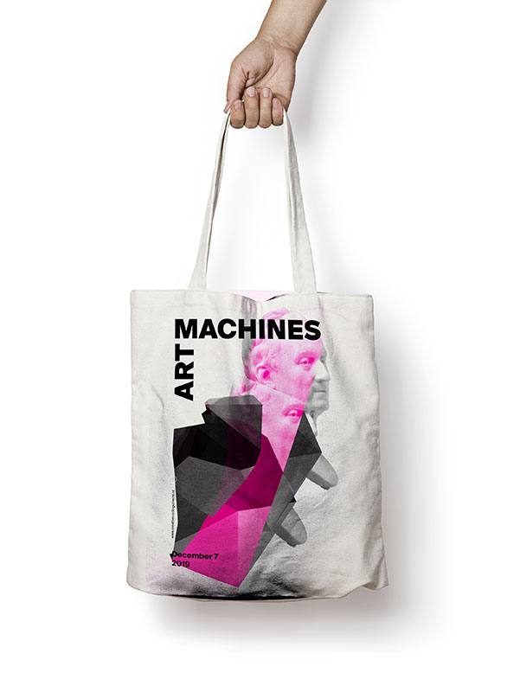
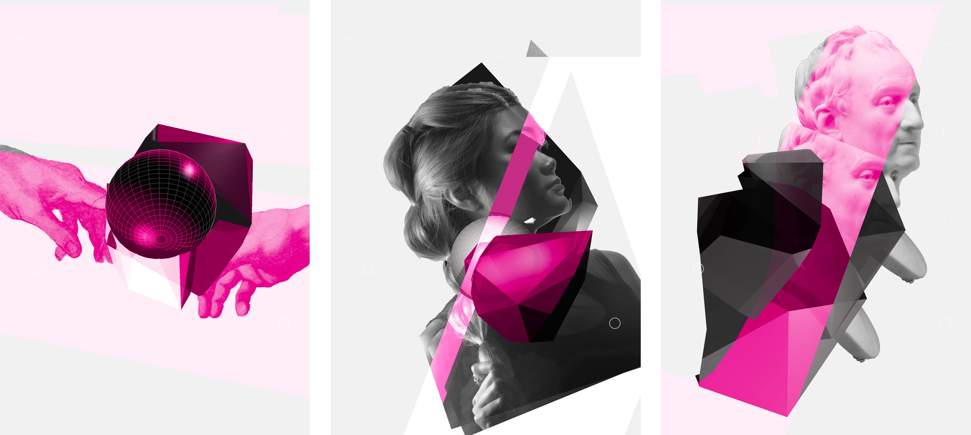
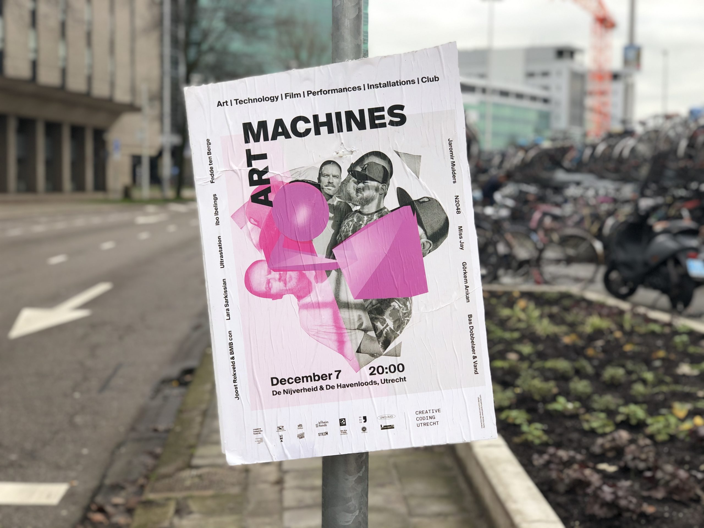
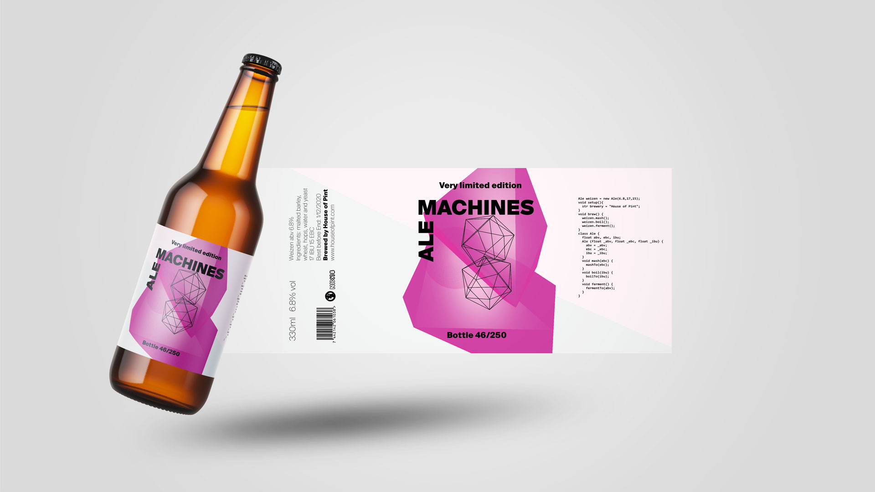
Art Machines

Slide 8
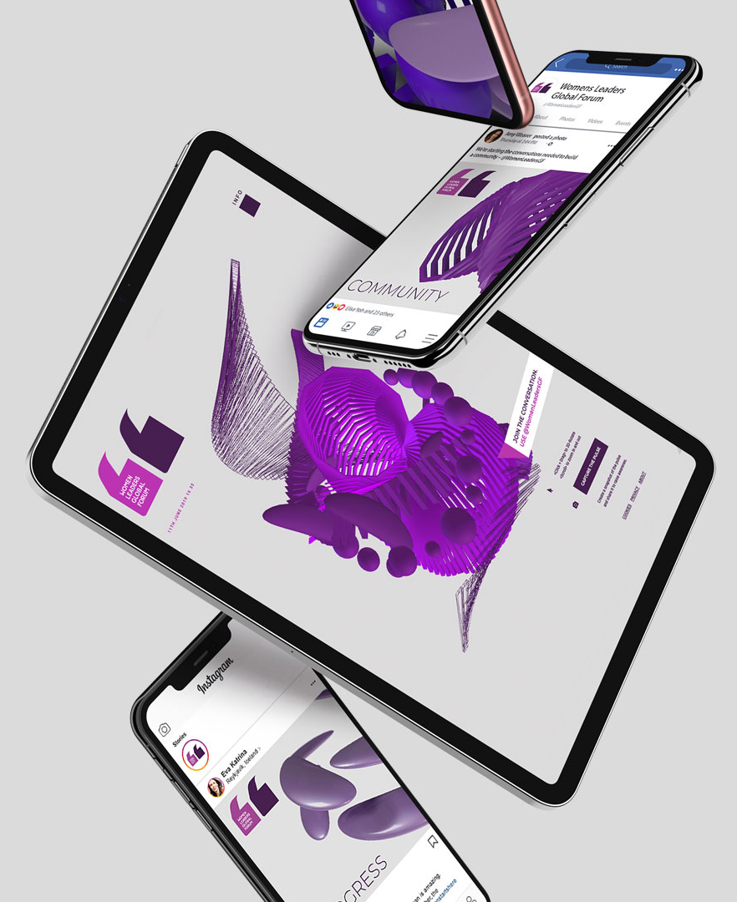
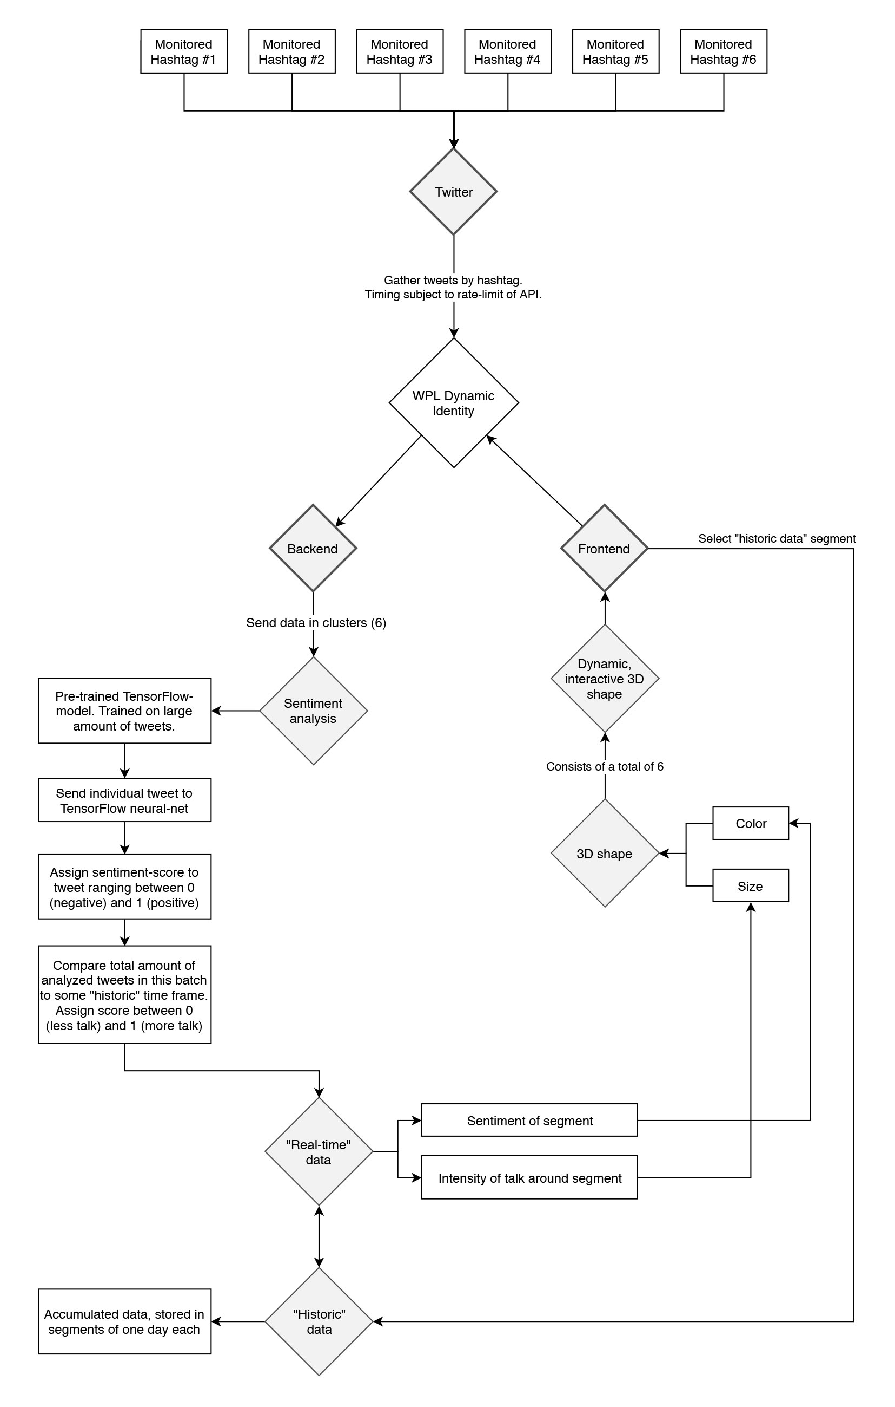
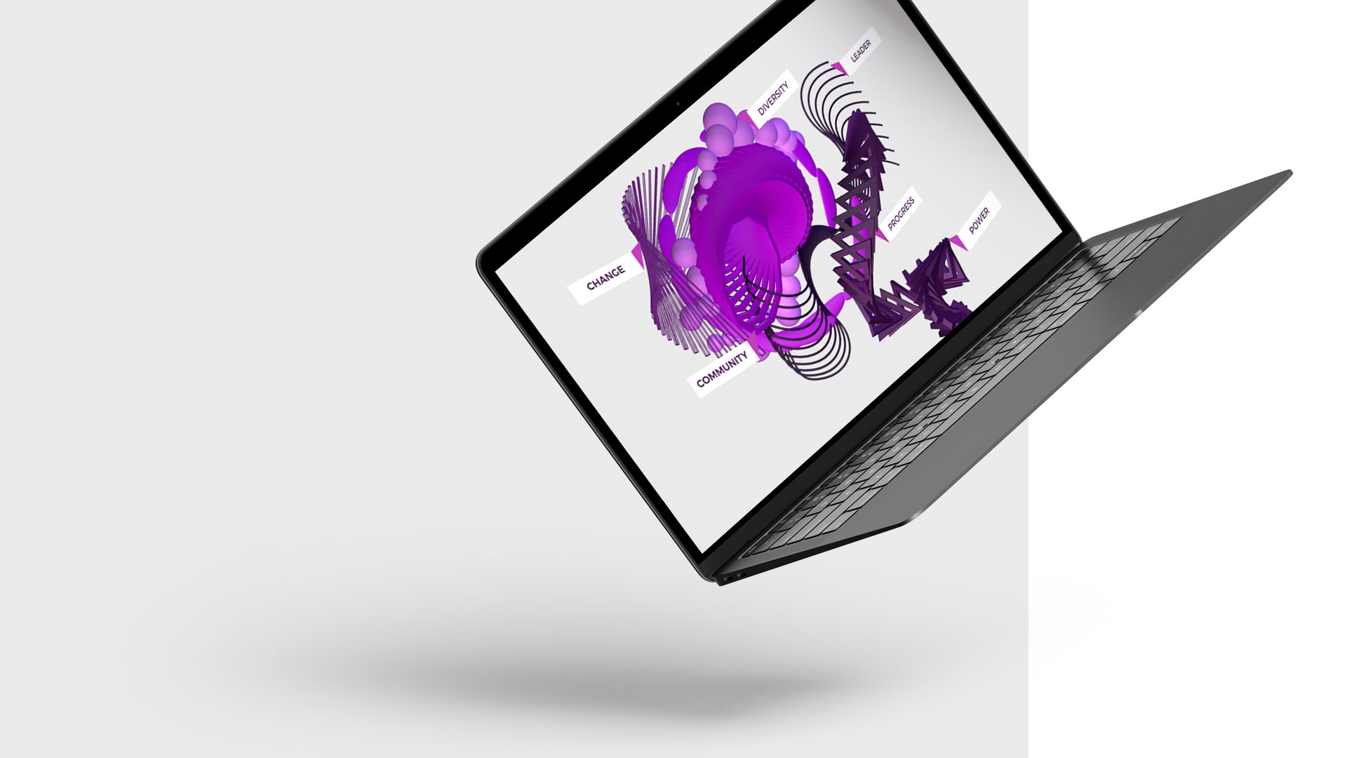
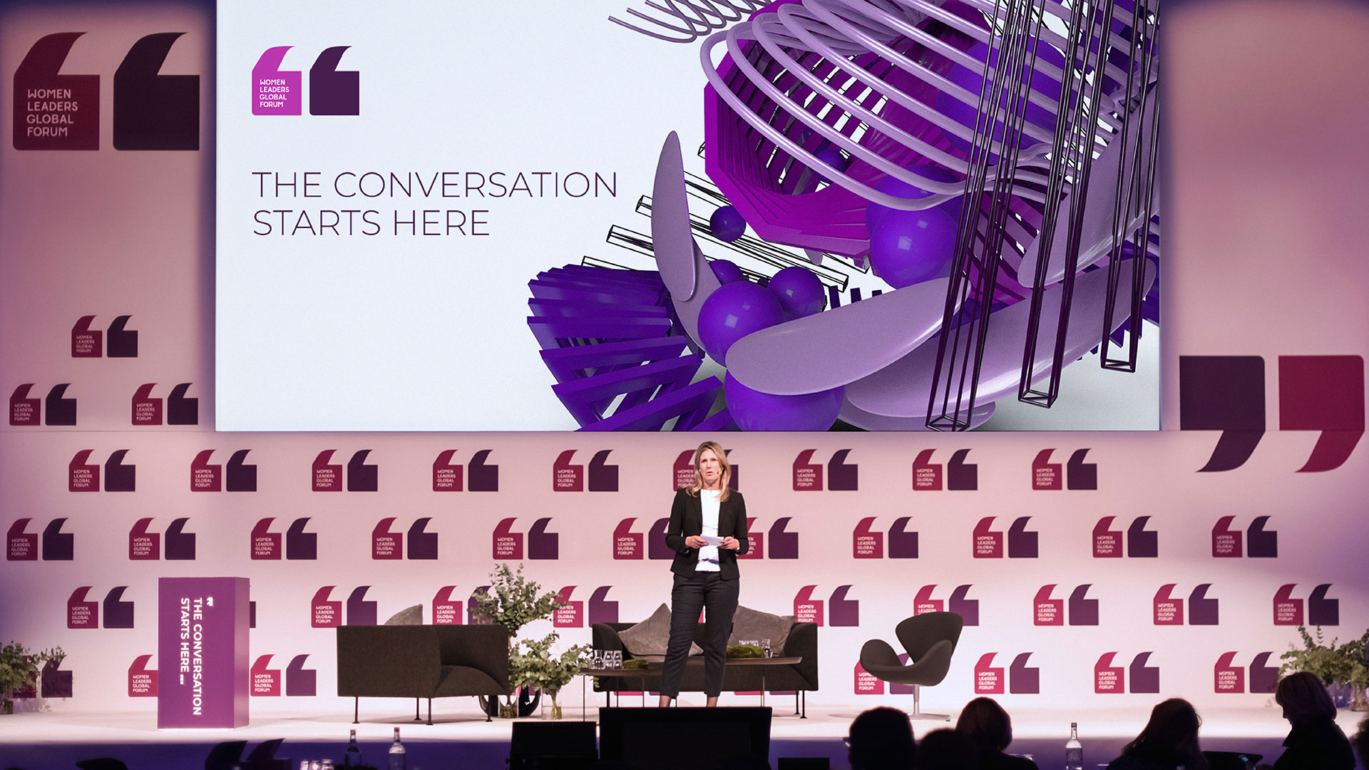
The Pulse

Slide 9
Why I like him

Slide 10
The impact that the work Patrick Hübner does can be seen within the communities he interacts with
The deeper connection is used for with cause
The impact of combining all these tools (big data and human interactions etc.) works surprisingly well
The impact of interactivity
Impact

Slide 11
The work he does is diverse and while it all seems to fall within generative art, that in itself has a significant amount of possibilities
The mood from each different project can differ and it is amazing the diversity in style he has
The ingenuity in the implementation and the creativity of using mathematics in different was to create interactive experiences
Creativity

